Slide 1

Senior ECAP
Class of 2023

Slide 2

Agenda
Your IRHS Counselors
Employ, Enlist, Enroll
Test Scores
Letters of Recommendation/ Application suggestions
FAFSA/ Scholarships
NCAA Eligibility Center
Official Transcript Request
Exit Ticket

Slide 3
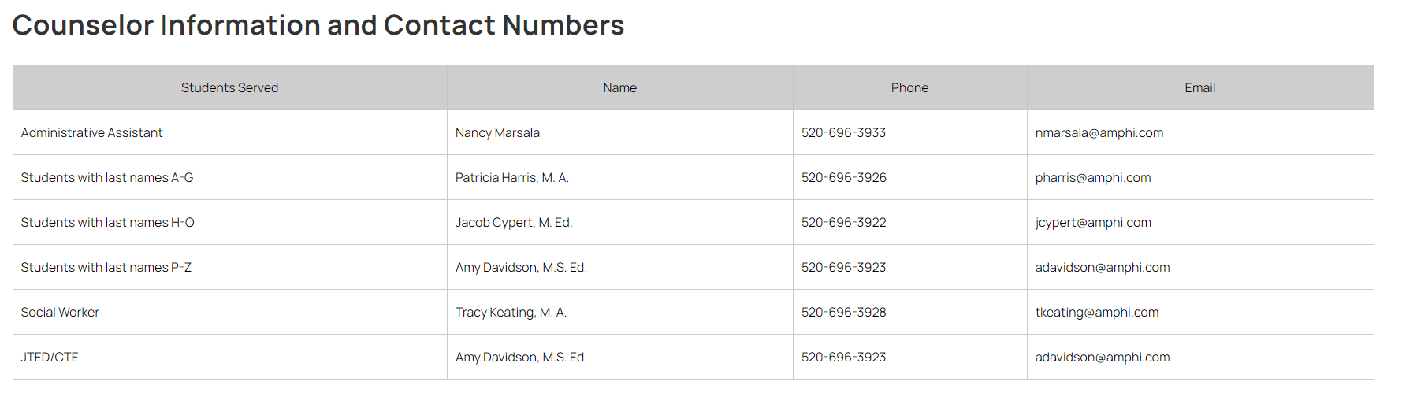

Slide 4

Employ
Develop cover letter and resume.
Ask teachers, coaches, employers to be references.
Research jobs/companies that fit your interests and skills - https://arizonaatwork.com/locations/pima-county/job-seeker-resources.
Apply for jobs.
Prepare and practice for interviews.

Slide 5




Employ
Major Clarity
  Career Exploration
    Videos, simulations
  Resume builder
J.A. Inspire
  Virtual Career Fair

Slide 6

Employ
www.jainspirejaarizona.vfairs.com

Slide 7

Enlist
Take the ASVAB – sign up in the Counseling office.
  November 1st or 16th, February 8th, April 12th
Talk to recruiters – https://www.military.com/join-armed-forces/recruiting-10-tips.html or when they visit campus.
Select the branch of military that meets your interests and skills.
Learn a skilled trade or make a career in the military.
Ask about educational opportunities.

Slide 8
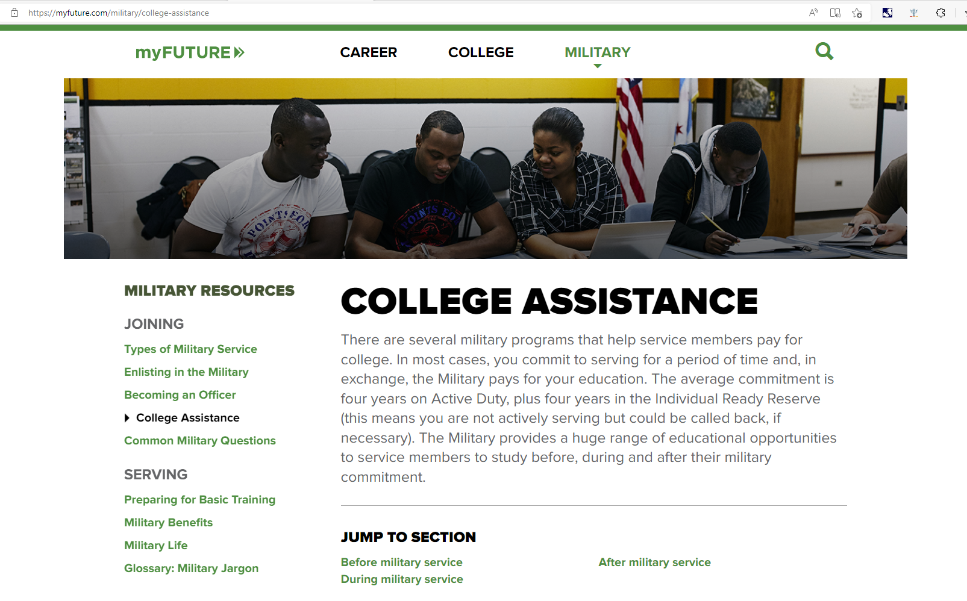
Enlist

Slide 9
Enlist
Tuition Assistance
Military Tuition Assistance is a benefit paid to eligible members of the Army, Navy, Marines, Air Force, and Coast Guard. Congress has given each service the ability to pay up to 100% for the tuition expenses of its members.
Each service has its own criteria for eligibility, obligated service, application process' and restrictions. This money is usually paid directly to the institution by the individual services.
GI Bill
GI Bill benefits help you pay for college, graduate school, and training programs. Since 1944, the GI Bill has helped qualifying Veterans and their family members get money to cover all or some of the costs for school or training.
Certifications
If your military training school doesn't offer college credit, it may offer certification in a specialized technical field instead. Many national trade associations recognize military certification tests. So, if you choose not to re-enlist, passing a certification exam helps you transition to your civilian career right away, without having to go through a long training period at lower pay.
Certification testing is available in the fields of automotive, computing, electronics, management, broadcast engineering, emergency medical technician, medical technology and food preparation, among many others.
Sources: www.myfuture.com/military/college-assistance and www.va.gov./education/about-gi-bill-benefits/

Slide 10



Enroll: 2-year community/technical college
  Apply for Fall 2023 -Application opens March/April 2023
  Apply for Financial Aid (FAFSA) – Opens October 1st
  Take placement tests/ Meet with Academic Advisor
  Attend Orientation
  Register and pay for classes
  Pima Community College Info - https://www.pima.edu/admission/apply-to-pima/index

Slide 11
Enroll: 4-year public or private college/university
PUBLIC
Check application deadlines
Apply online on college website
Request transcripts be sent to colleges
Send SAT/ACT scores if required
Check requirements if applying to honors colleges
PRIVATE
Check application deadlines (Early Decision, Early Action, Regular)
Apply on-line (Common App.)
Request transcripts
Send SAT/ACT scores if required
May need 2-3 teacher letters of recommendation
May need a counselor letter of recommendation

Slide 12



Enroll
Apply for Fall 2023
Email your counselor if you need an unofficial transcript to complete the application.
Application fees may vary depending on which application platform (college website, Common App., Coalition App., etc.).
For ASU, NAU, and UA use the university website.
If you qualify for Free/Reduced lunch, you may qualify for a fee waiver. See your counselor for more information.

Slide 13


SAT & ACT Test Scores
Many colleges are test optional. This means students are not required to take the tests or send the scores to complete the college application process.
Scores are often used for scholarship consideration and are still required for specific programs so be sure to check the college website for requirements.
If you have taken the SAT or ACT and need to send official test scores, please do so through the SAT and ACT websites.

Slide 14
Letters of Recommendation
Teacher Letter of Recommendation
  Check with the teachers NOW to ask if they will write one for you and to find out what they want from you.
  Please talk to your teacher before you invite them via Common App.
  Be sure to write a thank you note to the teacher for writing a letter for you!
Counselor Letters of Recommendation
  Request at least 2 weeks notice.
  Complete the LOR Request form on the Counseling website and send it to your counselor.

Slide 15
What makes a great application?
Professional and error free application.
Be authentic, genuine and confident.
Colleges are looking for well-rounded, likeable students who will make their campuses diverse.
What makes you different, unique and amazing. (clubs & activities)
Have someone review the essay and be sure to answer the prompt.
Choose your recommenders well.

Slide 16
Helpful hints for the application process……
Find the best college fit, it is different for each student. Consider majors, extra-curricular opportunities available, and how are you going to pay for it.
Designate a time at least once a week to work on applications. Include your parents in the process, but you should be doing all the work.
Each school has different requirements. Make a list of the schools, deadlines and requirements (essays, letters of recommendations, videos messages) for each application.
Keep copies of everything you submit!

Slide 17

FAFSA – Free Application for Federal Student Aid
Opens October 1st – colleges may require this to be completed to be eligible for some scholarships and loans.
https://studentaid.gov/h/apply-for-aid/fafsa
First Step: Create an FSA ID for both Student and Parent.
  Write it down so that you have it the following years.
Help Center - https://studentaid.gov/help-center/answers/landing
Make note of each school’s priority deadlines to complete the FAFSA.
FAFSA Help Video (about an hour long) https://zoom.us/rec/share/wcdWdauo6WZLUJGVynicdZ8bPaf5aaa81SYX_aYMyUtq2ABowSztjqU8A-zAOjpE

Slide 18
Scholarships – Free money for college
Merit vs. Private Donor
IRHS scholarship list – Updated 09/16/22
WUE – Western Undergraduate Exchange
Check the Financial Aid websites for each college you are applying to.
Always keep copies of every submission and awards

Slide 19
NCAA Eligibility Center
https://web3.ncaa.org/ecwr3/
Athletes should have registered at the end of their junior year with the Eligibility Center for participation in college athletics.
Contact Ms. Stevens in the Athletic Office or check IRHS’s Athletics webpage for more information.

Slide 20

Official Transcript Request
Complete the Transcript Request form for an official transcript.
  Can be found on the Counseling website or you can get a copy in the front office.
Please allow 3-5 working days to complete this request.
Each official transcript costs $1.00.
The official transcript will then be sent to the schools or organization you listed on the form.
Should you need a waiver, please talk to your counselor.

Slide 21
Final Reminders
Social Media
First Impressions
Watch Deadlines
You are being WATCHED!
About 30% of college admissions representatives say that they do a social media check on applicants.
Before you post: what does your digital footprint say about you?
Email address
Appropriate and Professional
Capitalize Proper Nouns
Use Punctuation
Application Deadlines
Scholarships
ACT/SAT
Acceptance and Refusals
Decision Day (May 1)

Slide 22

Exit Ticket & Questions
Please complete the Exit Ticket before leaving class.
Questions?

